Slide 1
C code Optimization
LongTD, AnhNV6

Slide 2
Objectives
Code optimization overview
Classification of optimization types
Optimization methods and terms
Document analysis tools
Common alogrithms

Slide 3
Code optimization overview
Code optimization involves the application of rules and algorithms to program code with the goal of making it faster, smaller, more efficient, and so on
Often these types of optimizations conflict with each other: for instance, faster code usually ends up larger, not smaller
Optimizations can be performed at several levels (e.g. source code, intermediate representations), and by various parties, such as the developer or the compiler/optimizer

Slide 4
Classification of code optimization
Local optimizations - Performed in a part of one procedure.
Common sub-expression elimination (e.g. those occurring when translating array indices to memory addresses.
Using registers for temporary results, and if possible for variables.
Replacing multiplication and division by shift and add operations.
Global optimizations - Performed with the help of data flow analysis (see below) and split-lifetime analysis.
Code motion (hoisting) outside of loops
Value propagation
Strength reductions
Inter-procedural optimizations
Global optimization allows the compiler/optimizer to look at the overall program and determine how best to apply the desired optimization level. Peep-hole provides local optimizations, which do not account for patterns or conditions in the program as a whole. Local optimizations may include instruction substitutions.
Notes:
There are some optimizations you can do, which a compiler can't, for example:
Using a fast algorithm;
Using unformatted I/O;
Using higher optimizations levels;
Performing "aggressive" manual optimization;
Writing in assembly language.
Optimizations that are performed automatically by a compiler or manually by the programmer, can be classified by various characteristics.

Slide 5
Optimization methods
Common sub-expression elimination
If the value resulting from the calculation of a sub-expression is used multiple times, perform the calculation once and substitute the result for each individual calculation
Normal | Optimization
float x = a*min/max + sx; float y = a*min/max + sy; | float temp = a*min/max; float x = temp + sx; float y = temp + sy;

Slide 6
Optimization methods (cont)
Constant propagation
Replace variables that rely on an unchanging value with the value itself
Normal | Optimization
x2 = 5; x3 = x1 + x2; | x3 = x1 + 5;

Slide 7
Optimization methods (cont)
Copy propagation
Replace multiple variables that use the same calculated value with one variable
Normal | Optimization
x2 = x1; x3 = x1 + x2; x2 = 3; | x3 = x1 + x1; x2 = 3;

Slide 8
Optimization methods (cont)
Dead code elimination
Code that never gets executed can be removed from the object file to reduce stored size and runtime footprint
Global register allocation
Variables that do not overlap in scope may be placed in registers, rather than remaining in RAM. Accessing values stored in registers is faster than accessing values in RAM
Inline calls
A function that is fairly small can have its machine instructions substituted at the point of each call to the function, instead of generating an actual call. This trades space (the size of the function code) for speed (no function call overhead).

Slide 9
Optimization methods (cont)
Instruction scheduling
Instructions for a specific processor may be generated, resulting in more efficient code for that processor but possible compatibility or efficiency problems on other processors. This optimization may be better applied to embedded systems, where the CPU type is known at build time
Lifetime analysis
A register can be reused for multiple variables, as long as those variables do not overlap in scope

Slide 10
Optimization methods (cont)
Loop invariant expressions (code motion)
Values that do not change during execution of a loop can be moved out of the loop, speeding up loop execution.
Normal | Optimization
for (int i = 0; i < length; i++) x[i] += pi + cos(y); | double temp = pi + cos(y); for (int i = 0; i < length; i ++) x[i] += temp;

Slide 11
Optimization methods (cont)
Loop unrolling
Statements within a loop that rely on sequential indices or accesses can be repeated more than once in the body of the loop. This results in checking the loop conditional less often.
Normal | Optimization
double temp = pi + cos(y); for (int i = 0; i < length; i++) x[i] *= temp; | double temp = pi + cos(y); for (int i = 0; i < length; i += 2) { x[i] *= temp; x[i+1] *= temp; }

Slide 12
Optimization methods (cont)
Strength reduction
Certain operations and their corresponding machine code instructions require more time to execute than simpler, possibly less efficient counterparts.
Normal | Optimization
x/4 x*2 | x >> 2 x << 1

Slide 13
Optimization methods (cont)
Steps of code size optimization
Step 1. Manual optimization
Dead store elimination;
Dead code elimination;
Lifetime analysis: A register can be reused for multiple variables, as long as those variables do not overlap in scope;
Constant propagation: Replace variables that rely on an unchanging value with the value itself;
Copy propagation: Replace multiple variables that use the same calculated value with one variable;
Not use inline calls.

Slide 14
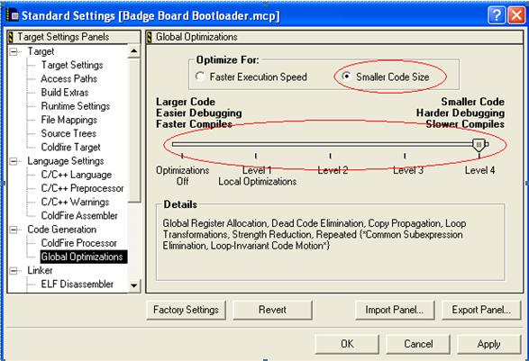
Optimization methods (cont)
Steps of code size optimization (cont)
Step 2. Using compiler options (tools)

Slide 15
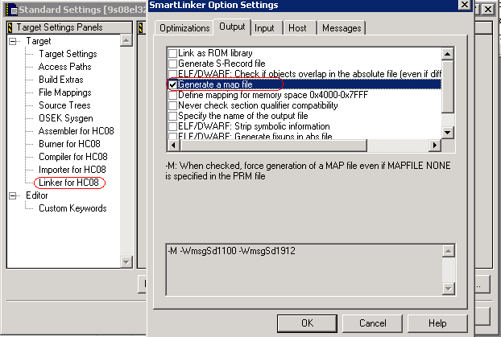
Optimization methods (cont)
Steps of code size optimization (Practice)
Step 1. Analyze code distribution in memory using Linker MAP file

Slide 16
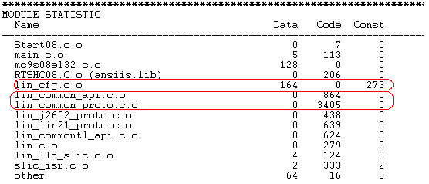
Optimization methods (cont)
Steps of code size optimization (Practice)
Step 2. Analyze the linker MAP file and identify the objects most memory consuming

Slide 17
Optimization methods (cont)
Steps of speed optimization
Step 1. Manual optimization
Dead code elimination;
Common sub-expression elimination;
Constant propagation;
Copy propagation: Replace multiple variables that use the same calculated value with one variable;
Global register allocation;
Inline calls;
Instruction scheduling;
Loop invariant expressions (code motion);
Loop transformations;
Loop unrolling;
Strength reduction;
Using a fast algorithm;
Writing in assembly language

Slide 18
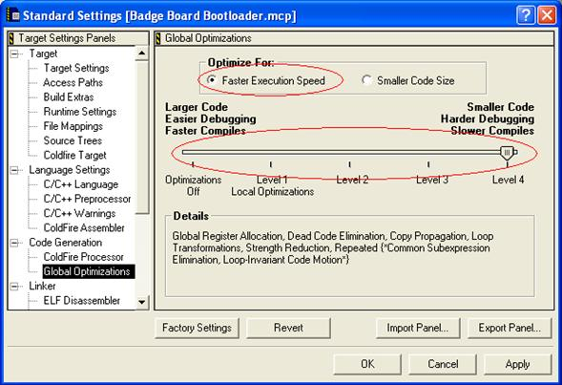
Optimization methods (cont)
Steps of speed optimization (cont)
Step 2. Using compiler options (tools)

Slide 19
Optimization methods (cont)
Steps of speed optimization (Practice)
Step 1. Profile the code
Profiling is the process of analyzing software to determine how much time, on average, an executable spends on a particular amount of code.
While profiling can reveal a lot of useful information about your code. Profiling identifies bottlenecks -- areas of code that hold back the entire performance of the system. Optimization attempts to make those bottleneck faster.
Most code loosely follows an 80/20 pattern of execution -- 80% of execution time is spent executing 20% of the code

Slide 20
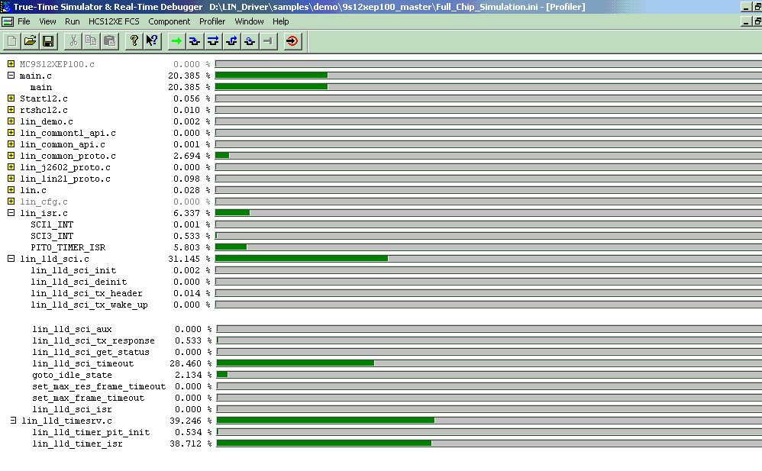
Optimization methods (cont)
Steps of speed optimization (Practice)
Step 1. Profile the code (cont)

Slide 21
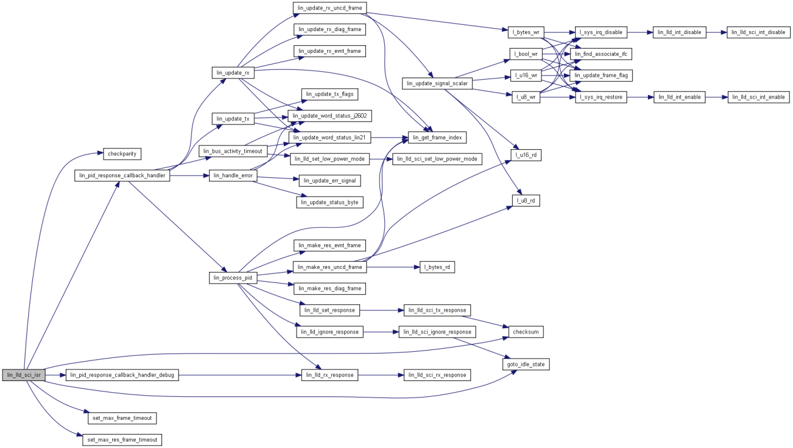
Optimization methods (cont)
Steps of speed optimization (Practice)
Step 2. Optimize for the speed
Inline Functions/Loop Unrolling/Strenght reduction
http://www.eventhelix.com/realtimemantra/Basics/OptimizingCAndCPPCode.htm
Minimize Interrupt Service Routine Overhead by keeping the ISR Simple
Interrupt service routines (ISRs) improve performance and ease maintenance. Because ISRs operate asynchronously, they are inherently difficult to debug; so keep their tasks to a minimum.
Try to move any data processing or housekeeping tasks out of an ISR and into the main program. Then, the ISR will only grab data, say, from hardware, place it in a buffer, raise a data-ready flag and re-enable the interrupt.

Slide 22
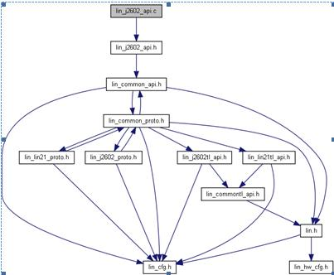
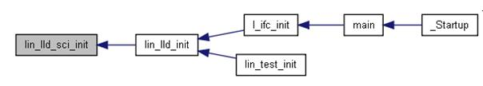
Document analysis tools (Doxygen)
Notes:
Doxygen is a documentation system for C++, C, Java, Objective-C, Python, IDL (Corba and Microsoft flavors), Fortran, VHDL, PHP, C#, and to some extent D.

Slide 23
Common Algorithms
Searching and sorting
Binary search
Bubble sort
Selection sort
Insertion sort
Strings
Brute-force algorithm

Slide 24
Q&A
Thank you!

